Slide 1
Focus
An eco-friendly learning platform.

Slide 2
The Vision of Focus
Providing a beneficial platform to learn any subject, regardless of the users’ circumstances.
Educate and guide our users to achieve their personal goals.
Create a positive effect on the environment by careful planning of an eco-friendly system architecture.

Slide 3
Problems
Lack of services available for mature students which could fit around their lifestyle.
Lack of quality education within the EU.
Higher education is only available to those in particular circumstances.
Environmental issues associated with using paper (creation, transport, printing).

Slide 4
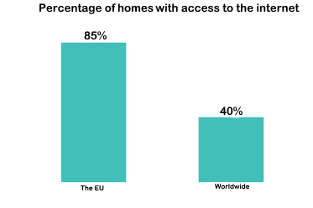
Solutions
Providing an accessible and intuitive learning platform to any device with internet.
Entirely digital system, removing the use for paper.
Education for any field, regardless of lack of facilities or information.

Slide 5
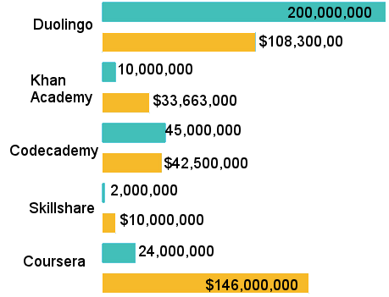
Current Market
Over $400,000,000 market cap
Rapid growth rate
Unique platform

Slide 6
Monetization
Powered by advertisements
Premium subscriptions which don’t directly benefit the user to keep opportunities equal, however a “pay forward” system.
Monetary pledges, when a goal is created, the user can choose to pledge money if the goal is failed. Funds would be used for the Focus project and collaborating with non-profits.

Slide 7
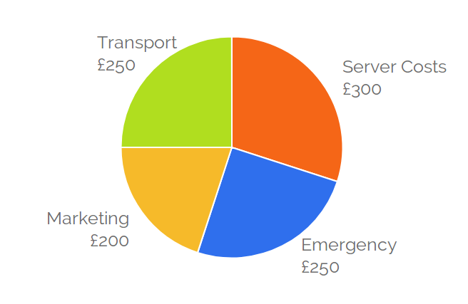
Budget allocation
Transport funds, to be used to attend meetings.
Server costs, to actually run the basic platform and purchase software such as SSL.
Marketing, to pay for AdSense and other online adverts, as well as potentially working with small teaching individuals or organizations.
Emergency funds, in case any unexpected costs occur, we’ll have a small safety net to fall back on.

Slide 8
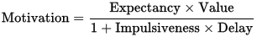
Initial Platform features
Tools for spaced repetition, a well-renowned method of studying and retaining information.
Guidance with attaining goals and general motivation. (TBT)
Information accessibility, being able to share learning resources on a global scale.
Cross-platform architecture, utilizing the Electron framework.

Slide 9
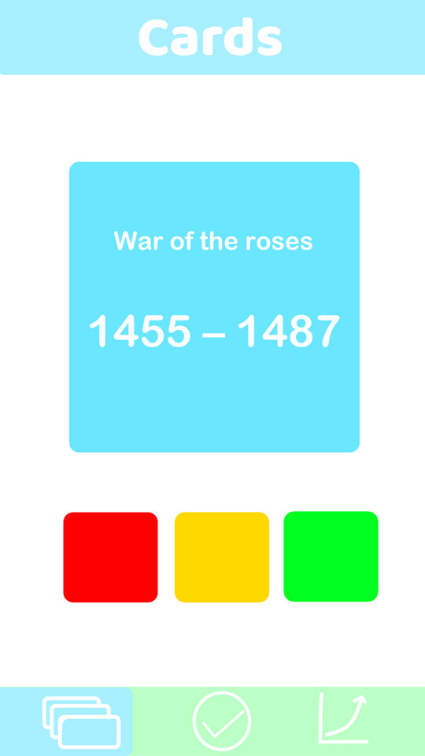
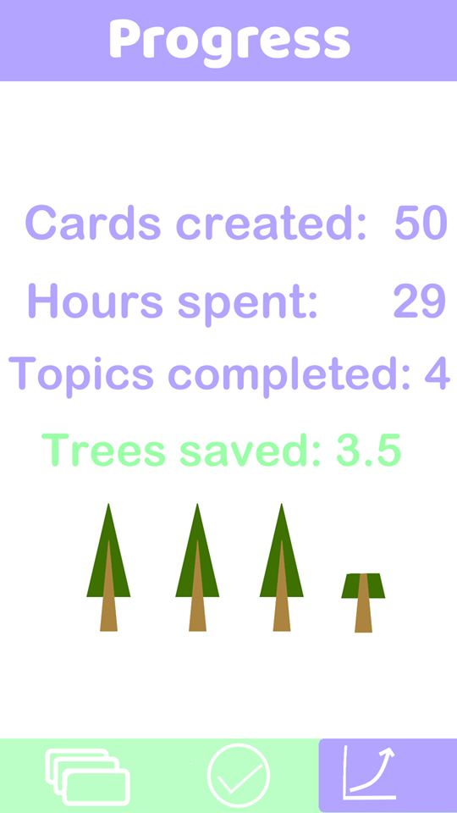
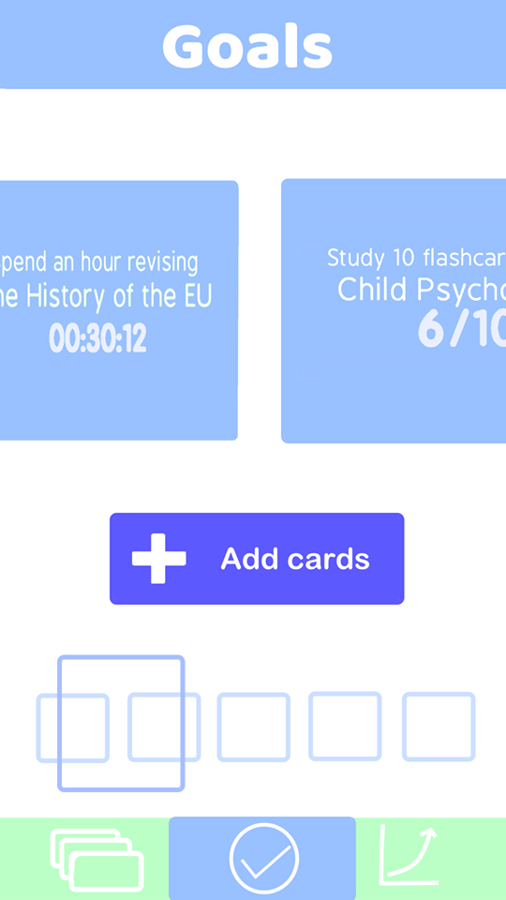
Initial Design

Slide 10
Future of focus
Partnering with existing educational platforms such as KhanAcademy which have an abundance of information to integrate our tools with.
Expanding the platform to utilize a sustainable and low energy technology such as block chain.
Non profit organization collaborations on important issues such as clean energy.

Slide 11
Any Questions?

